Slide 1
Figures – Chapter 9

Slide 2
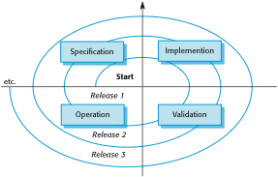
Figure 9.1 A spiral model of development and evolution

Slide 3

Figure 9.2 Evolution and servicing

Slide 4
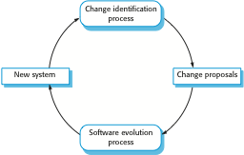
Figure 9.3 Change identification and evolution processes

Slide 5
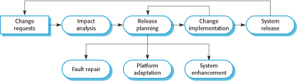
Figure 9.4 The software evolution process

Slide 6

Figure 9.5 Change implementation

Slide 7
Figure 9.6 The emergency repair process

Slide 8
Figure 9.7 Lehman’s laws
Law | Description
Continuing change | A program that is used in a real-world environment must necessarily change, or else become progressively less useful in that environment.
Increasing complexity | As an evolving program changes, its structure tends to become more complex. Extra resources must be devoted to preserving and simplifying the structure.
Large program evolution | Program evolution is a self-regulating process. System attributes such as size, time between releases, and the number of reported errors is approximately invariant for each system release.
Organizational stability | Over a program’s lifetime, its rate of development is approximately constant and independent of the resources devoted to system development.
Conservation of familiarity | Over the lifetime of a system, the incremental change in each release is approximately constant.
Continuing growth | The functionality offered by systems has to continually increase to maintain user satisfaction.
Declining quality | The quality of systems will decline unless they are modified to reflect changes in their operational environment.
Feedback system | Evolution processes incorporate multiagent, multiloop feedback systems and you have to treat them as feedback systems to achieve significant product improvement.

Slide 9
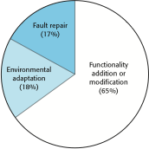
Figure 9.8 Maintenance effort distribution

Slide 10
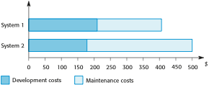
Figure 9.9 Development and maintenance costs

Slide 11
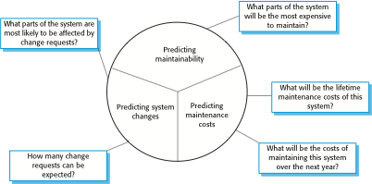
Figure 9.10 Maintenance prediction

Slide 12
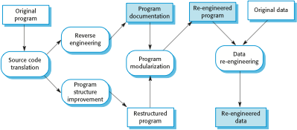
Figure 9.11 The reengineering process

Slide 13
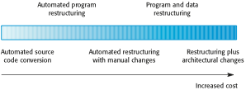
Figure 9.12 Reengineering approaches

Slide 14
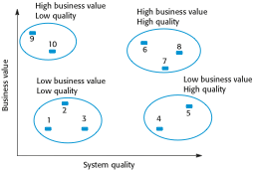
Figure 9.13 An example of a legacy system assessment

Slide 15
Figure 9.14 Factors used in environment assessment
Factor | Questions
Supplier stability | Is the supplier still in existence? Is the supplier financially stable and likely to continue in existence? If the supplier is no longer in business, does someone else maintain the systems?
Failure rate | Does the hardware have a high rate of reported failures? Does the support software crash and force system restarts?
Age | How old is the hardware and software? The older the hardware and support software, the more obsolete it will be. It may still function correctly but there could be significant economic and business benefits to moving to a more modern system.
Performance | Is the performance of the system adequate? Do performance problems have a significant effect on system users?
Support requirements | What local support is required by the hardware and software? If there are high costs associated with this support, it may be worth considering system replacement.
Maintenance costs | What are the costs of hardware maintenance and support software licences? Older hardware may have higher maintenance costs than modern systems. Support software may have high annual licensing costs.
Interoperability | Are there problems interfacing the system to other systems? Can compilers, for example, be used with current versions of the operating system? Is hardware emulation required?

Slide 16
Figure 9.15 Factors used in application assessment
Factor | Questions
Understandability | How difficult is it to understand the source code of the current system? How complex are the control structures that are used? Do variables have meaningful names that reflect their function?
Documentation | What system documentation is available? Is the documentation complete, consistent, and current?
Data | Is there an explicit data model for the system? To what extent is data duplicated across files? Is the data used by the system up to date and consistent?
Performance | Is the performance of the application adequate? Do performance problems have a significant effect on system users?
Programming language | Are modern compilers available for the programming language used to develop the system? Is the programming language still used for new system development?
Configuration management | Are all versions of all parts of the system managed by a configuration management system? Is there an explicit description of the versions of components that are used in the current system?
Test data | Does test data for the system exist? Is there a record of regression tests carried out when new features have been added to the system?
Personnel skills | Are there people available who have the skills to maintain the application? Are there people available who have experience with the system?

